Slide 1
Management 515
Managing Conflict, Politics, and Negotiation
© 2014, 2016 David E. Frick.
All rights reserved.

Slide 2
Organizational Conflict
The discord that arises when goals, interests or values of different individuals or groups are incompatible and those people block or thwart each other’s efforts to achieve their objectives.
Conflict is inevitable given the wide range of goals for the different stakeholders in the organization
Conflict (competition) can also exist between departments and divisions that compete for resources

Slide 3
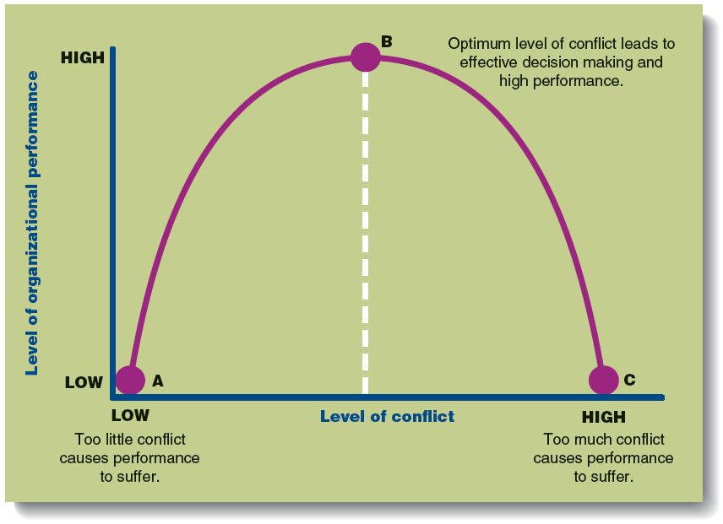
Conflict vs. Performance
Adapted from Contemporary Management, 8th. Jones and Garth
Notes:
You have seen this chart before. Some level of conflict must exist in an organization to achieve high performance. What is the ideal level of conflict? I do not know and anyone who claims they do is lying. What I do know is too much conflict is bad (nothing gets done) and too much conformance is bad (things get done, but maybe not the right things).

Slide 4
Types of Conflict
Interpersonal. Between individuals. May be based on personality conflicts, biases, history, social differences
Intragroup. Among individuals in a group. Conflict extends to affect performance of group
Intergroup. Between groups. May be healthy or unhealthy competition or an extension of interpersonal conflict
Interorganizational. Between organizations.

Slide 5
Sources of Conflict
Incompatible goals or time horizons.
Overlapping authority.
Status inconsistencies.
Scarce resources.
Task interdependencies.
Inequitable evaluation or rewards system.
Notes:
Conflict in a workplace setting can be a normal part of doing business. In some cases, conflict that is managed properly can be beneficial, as when it fosters an environment of healthy competition.
Change. Implementation of new technology can lead to stressful change. Workers who don't adapt well to change can become overly stressed, which increases the likelihood of conflict in the workplace.
Interpersonal Relationships. When different personalities come together in a workplace, there is always the possibility they won't mesh. Office gossip and rumors can also serve as a catalyst for deterioration of co-worker relationships.
Supervisor vs. Employee. Just as co-worker personalities may not mesh, a supervisor and employee can also experience conflict. A supervisor who is seen as overbearing or unfair can rub an employee the wrong way, which makes the working relationship more difficult.
External Changes. When the economy slides into a recession or a new competitor swoops in and steals some of a company's market share, it can create tension within the company. This stress can lead to conflict between employees and even between upper levels of management.
Poor Communication. Companies or supervisors that don't communicate effectively can create conflict. For example, a supervisor who gives unclear instructions to employees can cause confusion as to who is supposed to do what, which can lead to conflict.
Subpar Performance. When a worker in a department is not "pulling his weight," it can lead to conflict within the department, perhaps even escalating into a confrontational situation. A supervisor who fails to acknowledge or address the situation can add fuel to the fire.
Harassment. Harassment in the workplace can take many forms, such as sexual or racial harassment or even the hazing of a new employee. Companies that don't have strong harassment policies in place are in effect encouraging the behavior, which can result in conflict.
Limited Resources. Companies that are looking to cut costs may scale back on resources such as office equipment, access to a company vehicle or the spending limit on expense accounts. Employees may feel they are competing against each other for resources, which can create friction in the workplace.
Task Interdependencies. If coworkers fail to or poorly do something that affects your work or performance, hard feelings may result.
Inequitable rewards systems. See equity theory.

Slide 6
Strategies for Managing Conflict
Compromise. Each party is concerned about its own goal and the goal of the other party and is willing to engage in a give-and-take exchange to reach a solution: win-win or win-lose
Collaboration. Both parties try to satisfy their goals an approach that leaves them both better off and does not require concessions on issues that are important to either party: win-win
Accommodation. An conflict-handling approach in which one party, typically with weaker power, gives in to the demands of the more powerful party: win-lose

Slide 7
More Strategies
Avoidance. An ineffective conflict handling approach in which the parties try to ignore the problem and do nothing to resolve their differences: lose-lose
Competition. An conflict handling approach in which each party tries to maximize its own gain and has little interest in understanding the other party’s position and arriving at a solution that will allow both parties to achieve their goals: typically lose-lose
Negotiation. Method of conflict resolution in which the parties reaches a solution acceptable to all of them: win-win or win-lose

Slide 8
Approaches
Facilitation. Conducted by an impartial individual with expertise in handling conflicts and negotiations who helps parties in conflict reach an acceptable solution. A facilitator does not influence the discussion
Mediation. A mediator facilitates negotiations but has no authority to impose a solution. A mediator can influence the course of the discussion
Arbitration. After hearing arguments, an arbiter crafts a solution
Binding. Both parties are obligated to abide by the solution
Non-binding. Either or both parties can reject solution
Notes:
Alternative dispute resolution (ADR) includes dispute resolution processes and techniques that act as a means for disagreeing parties to come to an agreement short of litigation. It is a collective term for the ways that parties can settle disputes, with (or without) the help of a third party.
Some courts now require some parties to resort to ADR of some type, usually mediation, before permitting the parties' cases to be tried.
The rising popularity of ADR can be explained by the increasing caseload of traditional courts, the perception that ADR imposes fewer costs than litigation, a preference for confidentiality, and the desire of some parties to have greater control over the selection of the individual or individuals who will decide their dispute.
Facilitators, mediators, and arbitrators should be trained for the task. Many mediators and arbitrators are former lawyers or judges appointed by some government entity.

Slide 9
Negotiation
Distributive.
Parties perceive that they have a “fixed pie” to divide
Take a adversarial stance
See no need to interact in the future
Do not care if their interpersonal relationship is damaged by their competitive negotiation
Bargaining.
Parties perceive that they might be able to increase the resource pie with a creative solution: win-win
Used with many approaches
Notes:
Negotiation is a dialogue between two or more people or parties intended to reach a mutually beneficial outcome, resolve points of difference, to gain advantage for an individual or collective, or to craft outcomes to satisfy various interests.
Negotiation occurs in business, non-profit organizations, government branches, legal proceedings, among nations and in personal situations such as marriage, divorce, parenting, and everyday life.
Negotiations can be heavily affected by the cultures of the negotiating parties. In some cultures, making concessions in a negotiation can be viewed as unmanly. The unwillingness to give a little can lead to bad outcomes for all.

Slide 10
Some Tips
Take emotion out of the game. Take the time needed to calm down before you tackle an issue. If you are perceived as emotional, you loose credibility
Let everyone speak.
The more you listen, the better you understand all sides
Those not allowed to speak will feel they are being treated unfairly
Choose your battles. Avoid being the boy who cried wolf. Each battle cost you political capital which is not unlimited

Slide 11
Some More Tips
Avoid gossip. Workplace gossip (which is usually not true) leads to bad blood and office anguish
Be polite in your language. The use of harsh or obscene words will only make matters worse and may lead to claims of a hostile workplace
Don’t internalize criticism. Everyone has a bad hair day. Don’t take every remark as a personal attack
Try to separate business and personal. Don’t seek out office romance. They usually do not end well. If it happens, avoid any perception of preferential treatment

Slide 12
And Some More
Use active listening. You must make every effort to fully understand all positions. You are foolish to allow disagreements to be built on misunderstandings
Be open to compromise. Compromise can be win-win. Don’t compromise your principles, but also do not allow stubbornness to rule the day
Use a mediator, if possible. A disinterested third party can add credibility to any negotiation
Expect conflict. Some conflict is healthy. A conflict-free workplace is a dying workplace. Improve your skills
Notes:
Active listening is a way of listening and responding to another person that improves mutual understanding. Often when people talk to each other, they do not listen attentively. They are often distracted, half listening, half thinking about something else. When people are engaged in a conflict, they are often busy formulating a response to what is being said. They assume that they have heard what their opponent is saying many times before, so rather than paying attention, they focus on how they can respond to win the argument.
Active listening is a structured form of listening and responding that focuses the attention on the speaker. The listener must take care to attend to the speaker fully, and then repeats, in the listener’s own words,. The listener does not have to agree with the speaker, but simply state what was said. This enables the speaker to find out whether the listener really understood. If the listener did not, the speaker can explain some more.
Active listening has several benefits.
--It forces people to listen attentively to others.
--It avoids misunderstandings, as people have to confirm that they do really understand what another person has said.
--It tends to open people up, to get them to say more. When people are in conflict, they often contradict each other, denying the opponent’s description of a situation. This tends to make people defensive, and they will either lash out, or withdraw and say nothing more.

Slide 13
Politics
Organizational. The activities managers engage in to increase their power and to use power effectively to achieve their goals or overcome resistance or opposition
Can be viewed negatively when managers act for their own benefit (see Agency Theory)
Can be a positive force that can bring about needed change when political activity allows a manager to gain support for needed changes that will advance the organization
Political Strategies. Tactics that managers use to increase their power and to use power effectively to influence and gain the support of other people while overcoming resistance or opposition

Slide 14
Political Strategies
Relying on objective information | Objective information instills confidence in manager’s position
Bringing in an outside expert | Expert opinion lends credibility to manager’s position
Controlling the agenda | Influencing alternatives limits the potential opposition to manager’s position
Making everyone a winner | Benefiting all may result in group-wide support
Controlling uncertainty | Reduced uncertainty has a calming effect on all stakeholders
Centralizing power | Greater influence over firm’s resources increases manager’s influence
Generating resources | The rainmaker has greater influence to senior managers
Building alliances | Mutually beneficial relationships can lead to greater influence
Adapted from Contemporary Management, 8th. Jones and Garth

